Slide 1
Feeling seen: Emotional Presence in NPC Interaction
Enhancing Presence Through Real-Time Player Emotion Detection
Month Year

Slide 2
High Level Overview
Digital characters in games often behave like scripted machines → predictable, emotionally flat, and indifferent to the player’s mood
Players, meanwhile bring real emotions into play: frustration, joy, curiosity, irritations.
Our project asks: what happens when a game character can actually notice and respond?
Research Aim: To explore how emotional responsiveness→ through facial-expression and voice cues—can transform a purely robotic NPC into a character that feels socially present.
We’re testing whether small, real-time reactions (tone, animation, lighting, personality) make players perceive stronger connection, empathy, and “aliveness.”
Concept overview: An interactive villager prototype that bridges the gap between robotic systems and human connection through emotion-aware design.
Notes:
Break into 2 slides
Highlevel overview- intervention in game dev pipline
2 things in the development process
Things we r doing to streamline the current pipeline – how does this improve on current processes- more efficiency, reduce time, easier accessible
What does this open up in terms of new games-> new possibilities in new games → living, completely interactable game world→ multitude

Slide 3
Prototype Description
On screen NPC Character
Detects player facial emotion in real time
Reacts physically (posture, animation, gaze, lighting)
Listens to player speech and generates short mood-aligned replies
Displays personality and boundaries (sarcasm when challenged, friendliness when greeted)
Interaction Loop:
Walk up → It perceives your expression → You speak → It replies with matching attitude and tone.
Outcome→ small but polished emotional-presnece prototype that demonstrates
Real-time emotion detection working in a game context
Believable NPC behavior driven by player affect
UX insights about designing emotionally reciprocal AI characters

Slide 4
Why Do This?
Game characters feel alive when they notice us.
Strengthens emotional connection in storytelling
Enhances presence in gameplay
Supports human-technology emotional literacy
Emerging tech direction in AAA + VR experiences
Optional stat callout: “Over 70% of player feedback in narrative games relates to emotional immersion.
Games are emotional spaces. Players routinely project feelings onto characters, yet most NPCs remain emotionally static, locked to canned behabiors regardless of the player’s mood. The gap is fascinating. If a digital character could subtly read and respond based to a player’s facial expressions, even in a small way, the interaction could feel more alive.
The aim of this project is to explore whether emotional mirroring:
Increases the sense of presence
Improves player empathy towards NPCs
Helps players feel seen by technology in a positive way
Deepens storytelling in even the simplest interaction
To investigate how real-time emotional responsiveness affects:
• player immersion
• perceived “aliveness” of NPCs
• empathy + presence in interaction
Notes:
Right now, building interactive environments is time-consuming and resource-heavy. Large studios can afford teams of designers to tag and test affordances across thousands of assets — smaller studios simply can’t. That creates an accessibility gap in the industry: rich, interactive worlds are a privilege of scale.
Our intervention closes that gap. It automates affordance tagging directly from 3D geometry meaning even a small studio or classroom can create objects that ‘understand’ what they afford. It’s intuitive, no ML background needed, and it brings the same expressive power of big studios to independent creators.
On the player side, it also improves accessibility and clarity — affordances become consistent and predictable across games, making it easier for players to know what they can do in the world.”

Slide 5
What We Already Think We Know
Initial assumptions (soon to be tested)
• Real-time emotion feedback feels human • Faster + more subtle reaction = more believable • Players want technology to understand them • Some emotion types (joy, surprise) are easier to detect reliably • Too-strong reactions might feel creepy or invasive
Notes:
Right now, when game designers import a chair or table into Unreal, they have to manually define every collider, tag, and interaction. We’re trying to build a geometry-aware ML system that automates that, something that understands shapes the way humans do. That means faster workflows, accessible design tools, and a step toward game worlds that feel alive and consistent.

Slide 6
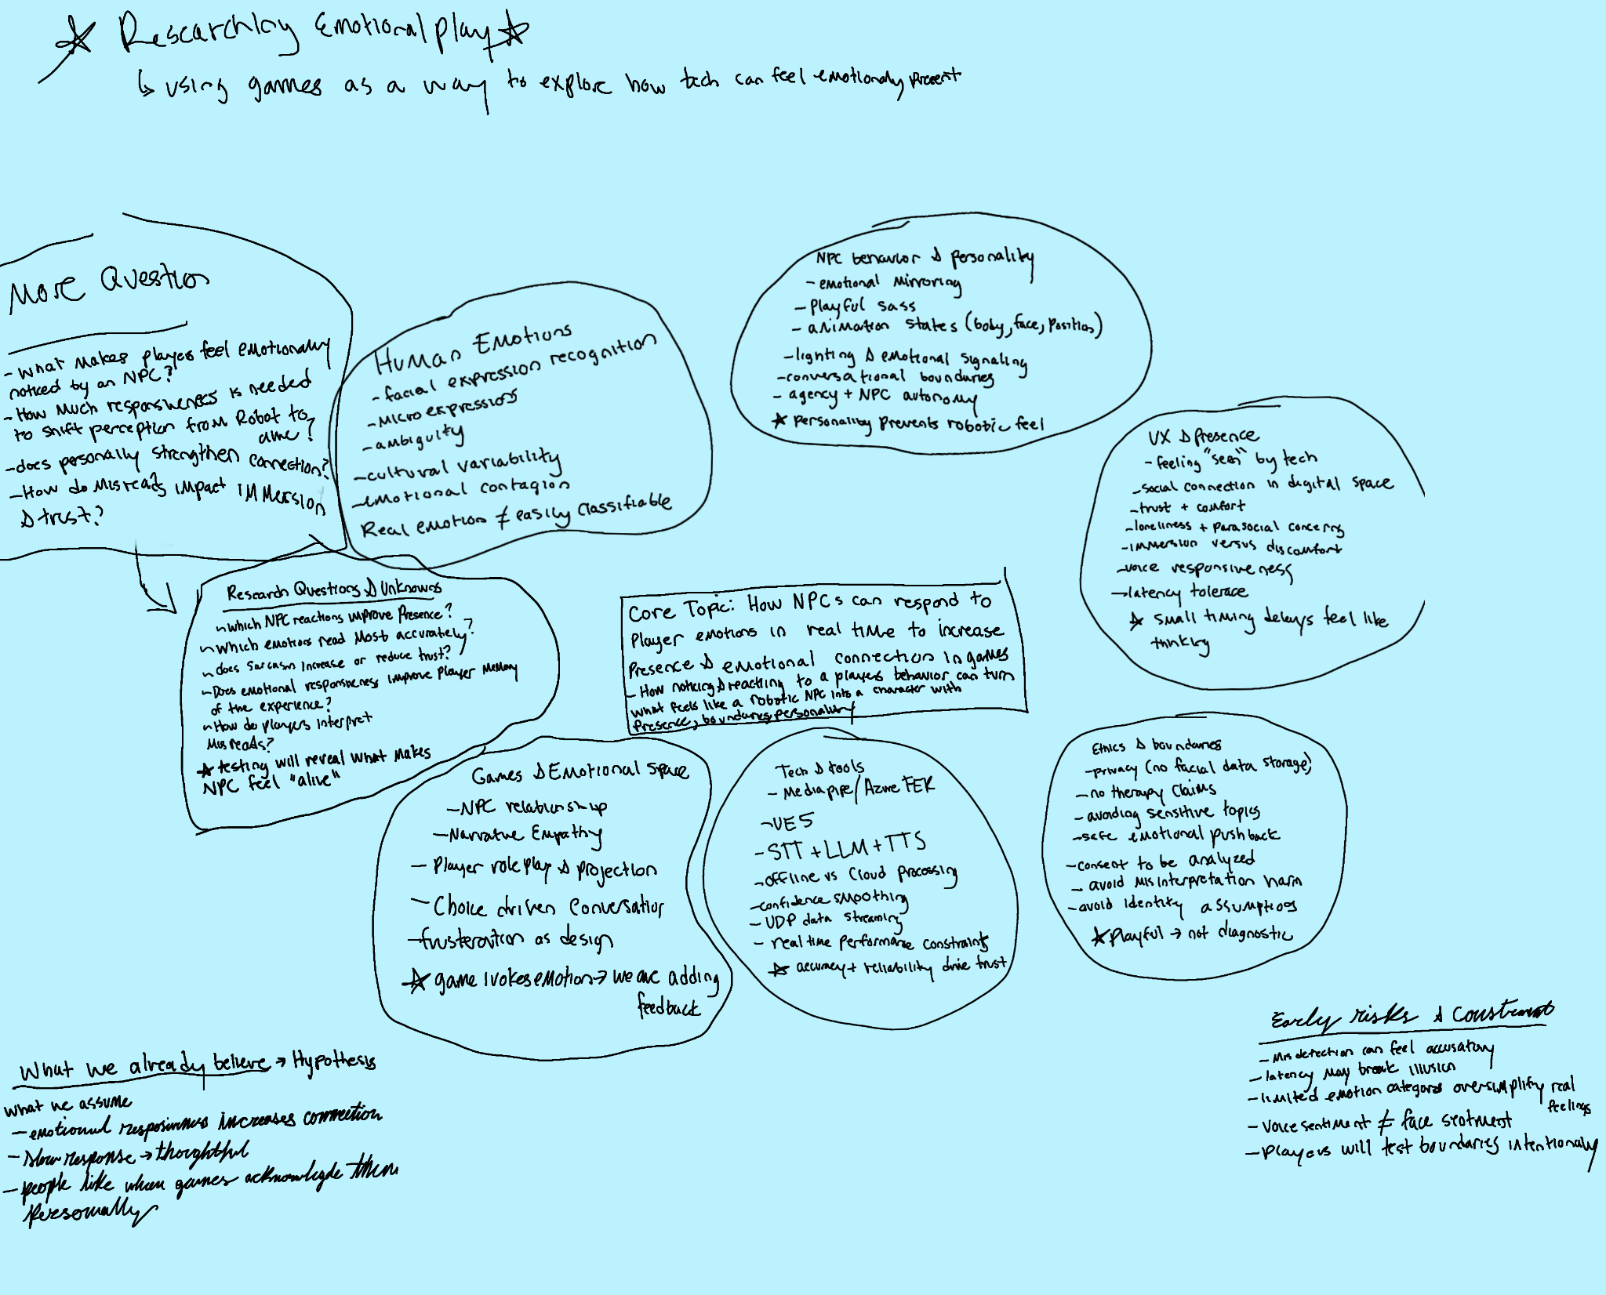
Mess Map: Emotional NPC Interaction
Notes:
Break into 2 slides
Highlevel overview- intervention in game dev pipline
2 things in the development process
Things we r doing to streamline the current pipeline – how does this improve on current processes- more efficiency, reduce time, easier accessible
What does this open up in terms of new games-> new possibilities in new games → living, completely interactable game world→ multitude

Slide 7
UX and Research Focus (add to)
What makes players feel emotionally noticed by an NPC?
• How much responsiveness is needed to shift perception from “robotic” to “alive”?
• Does personality (playful, defensive, curious) strengthen connection?
• Which emotional triggers feel delightful vs. uncomfortable?
• How do misreads impact immersion and trust?

Slide 8
Pre Survey

Slide 9
User Testing overview: Goal is to understand how players experience emotional presence when an NPC reacts to their expressions and tone
Testing format:
Playtesting sessions (10 -15 mins each)
1-6 participants
Individual sessions so each person interacts directly
Conducted in setup with webcam and mic
Once each participant tests→ completes a short survey + debrief interview
Data Collection Methods:
Observation recording (with permission)
Quick post interaction survey
Short interview or discussion
We will run short individual playtests where participants interact with the emotion-responsive NPC and then complete a brief survey and debrief interview to measure perceived presence, empathy, and comfort. The goal is to evaluate how emotional responsiveness changes the quality of human–machine connection.

Slide 10
New Possibilities for Game Design
NEW POSSIBILITIES AND OPPORTUNITIES IF WE SUCCEED
Emotion as Input, not use Output → Games could adjust difficulty or pacing based on visible frustration or fatigue.
Horror games could detect real fear and modulate tension (imagine AI noticing you aren’t scared enough)
Cozy or narrative games could slow down, soften tone, or offer empathy when you look stressed
NPCs as Emotional Mirrors→ Your prototype demonstrates how NPCs can act like emotional mirrors — subtly matching or contrasting a player’s tone to create social realism
Companions who comfort you or tease you depending on your mood
Shopkeepers who treat you differently if you look grumpy or tired
Mood-Driven Narrative Systems→ Traditional branching narratives rely on explicit player choices (“Say yes / Say no”). An emotional-responsive system could branch implicitly, using real-time affect.
A character reacts with concern because you looked anxious during dialogue.
The story’s lighting and music adapt to match the player’s emotional tone.
Rehumanizing AI Characters→ positions game AIs as emotionally readable agents rather than code puppets
Characters who don’t just talk at you, but with you.
Conversations feel more like improv
Procedural NPCs that have individual moods, making crowds feel alive.

Slide 11
Texts/Research docs
Our Github: https://github.com/Kstuteville/Emotion-NPC-Prototype
Affective Computing
Calvo, R. A., D’Mello, S., Gratch, J. (Jonathan M., & Kappas, A. (Eds.). (2015). The Oxford handbook of
affective computing. Oxford University Press.
Poria, S., Majumder, N., Mihalcea, R., & Hovy, E. (2019). Emotion Recognition in Conversation:
Research Challenges, Datasets, and Recent Advances. IEEE Access, 7, 100943–100953.
https://doi.org/10.1109/ACCESS.2019.2929050
Hama, K., Otsuka, A., & Ishii, R. (2024). Emotion Recognition in Conversation with Multi-step
Prompting Using Large Language Model. In SOCIAL COMPUTING AND SOCIAL MEDIA, PT I,
SCSM 2024 (Vol. 14703, pp. 338–346). Springer Nature Switzerland.
https://doi.org/10.1007/978-3-031-61281-7_24
https://link.springer.com/article/10.1007/s10462-024-11010-y?
Notes:
For Theory & Background Slide / Section:
Use the Oxford Handbook and the appraisal models chapter to explain:
What is affective computing
Key theories of emotion (e.g., appraisal theory)
How affect is used in interactive systems (games, agents)
For Detection & Conversation Systems:
Use the Poria et al. paper + the 2024 survey to cover:
Emotion recognition methods (face, voice, text)
Datasets and their limitations
Conversation design with emotional inputs
For UX / Empirical Constraints:
Use dataset reviews or open access data papers to show:
What challenges exist (accuracy, ambiguity, culture, modality)
Why you’re limiting to 3 emotions for your prototype
Why you’re doing smoothing, latency control, etc.

Slide 12
Early Inspiration & Precedents
Initial assumptions (soon to be tested)
A few smart references
• LA Noire (facial reading gameplay) • Hellblade (inner emotional feedback systems) • VTubing reactive avatars • Research in affective computing for education + therapy
Notes:
Right now, when game designers import a chair or table into Unreal, they have to manually define every collider, tag, and interaction. We’re trying to build a geometry-aware ML system that automates that, something that understands shapes the way humans do. That means faster workflows, accessible design tools, and a step toward game worlds that feel alive and consistent.

Slide 13

7 Week Map

